Slide 1
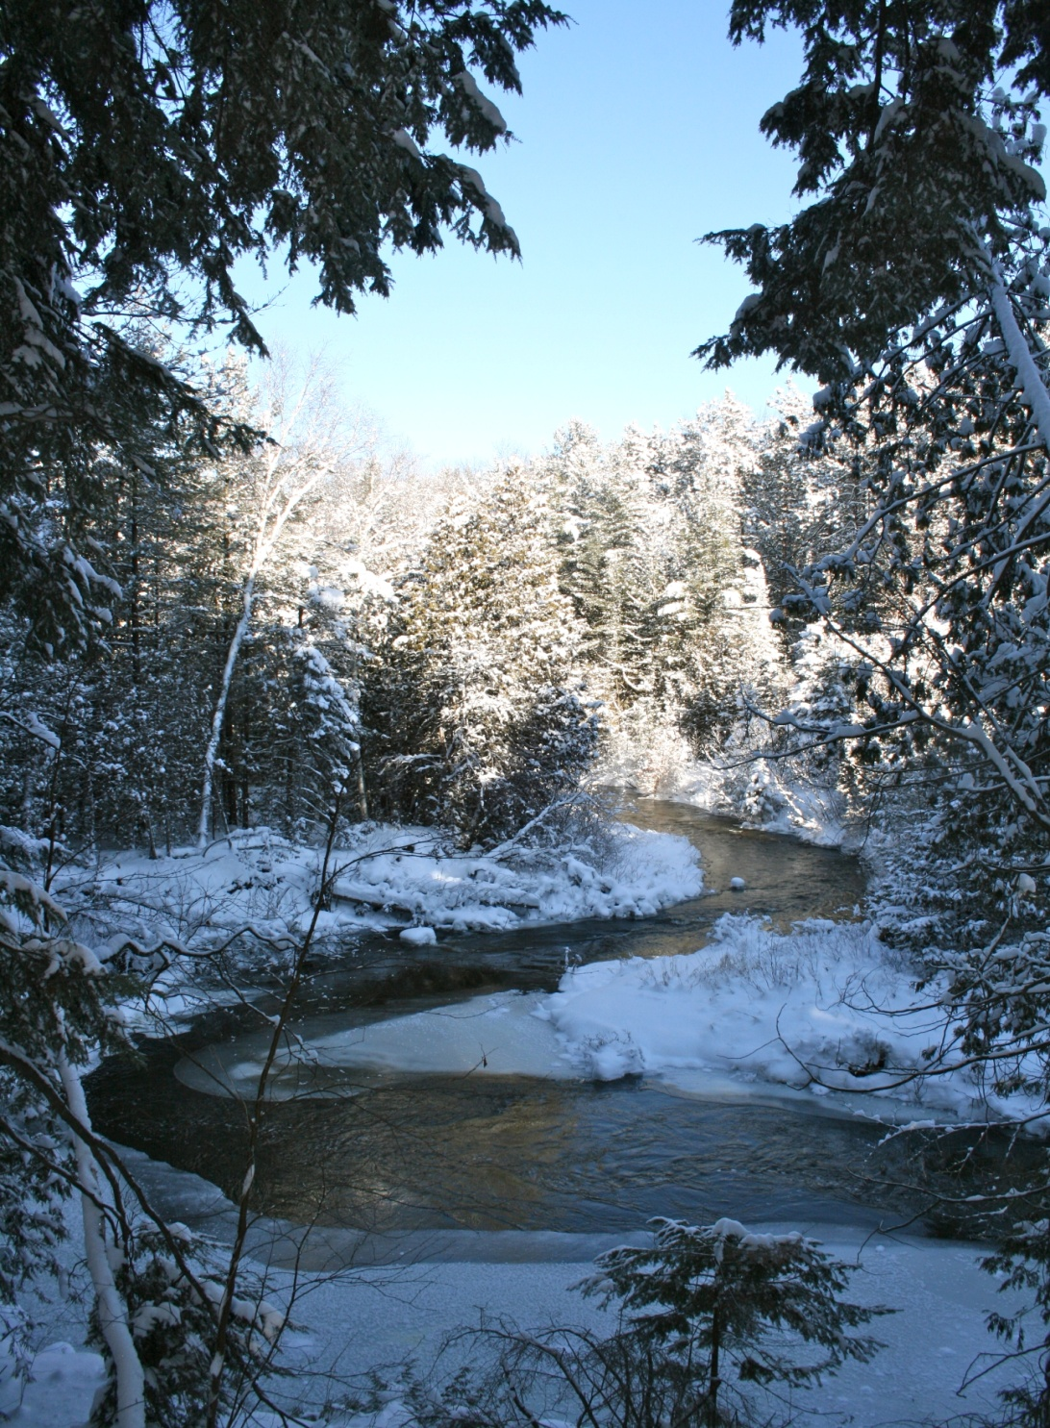
The Midhurst Ratepayers Association
Delegation to Springwater Township Council
April 16, 2012

Slide 2
The Midhurst Ratepayers Association (MRA)
Was started in 2007 and Incorporated on March 26, 2009
To have our
Collective Voice Heard

Slide 3
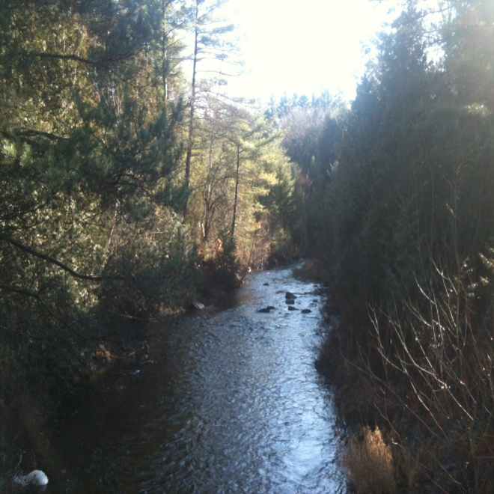
Who we represent
We represent the interests of the property owners and residents of Midhurst
Our Directors
Paul Fleming, President
Bill Nieuwland, Vice President
David Strachan, Sec/Treasurer
Robert Lines, Director at Large

Slide 4
Reason for this Delegation
We believe that the residents of Midhurst were not adequately notified about opportunities for public input or adequately consulted during the development of the Midhurst Secondary Plan (MSP).
We submit this petition of more than 1400 signatures to indicate the extent to which the citizens of Midhurst disagree with the contents of the Secondary Plan, and oppose the approval of this plan by the Township of Springwater and by the County of Simcoe.

Slide 5
Questions from the Residents of Midhurst
Upon investigation of the plan and extensive discussion with concerned citizens, we have devised a list of questions regarding the MSP.
We ask that the Township of Springwater respond to these questions formally and publicly.

Slide 6
Projected Growth Rates
Annual Grow Rate
Barrie has been designated as the only urban growth centre in the Simcoe sub-area. With an annual growth rate of 2.8% .
The MSP plans to add 24,624 new residents, creating a projected growth rate for the village of Midhurst of over 30% per year.
Would Council explain to us why an annual urban growth rate of 30% is necessary in our rural village?

Slide 7
Traffic
According to your own transportation studies, the existing roads in Midhurst will be significantly overwhelmed by traffic congestion in the near future. This will create roads that are unsafe and extremely busy. The sheer volume of traffic will alter the existing character of our quiet, rural village.
How does Council plan to protect the existing village of Midhurst from serious traffic congestion?

Slide 8
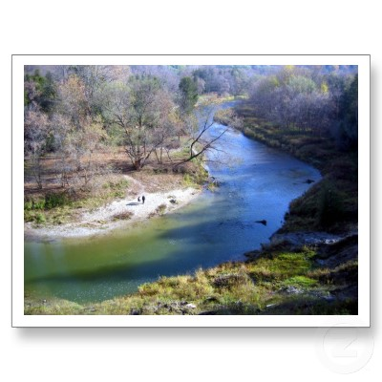
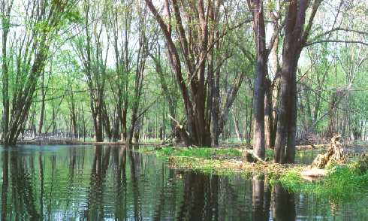
Environment
The MSP proposes aggressive development that will put at risk our natural environment including Willow Creek, the Nottawasaga watershed and our ground water resources. It will also destroy prime agricultural land.
What measures will Council take to deal with the inevitable land use conflicts and damage to our natural environment that will arise from intensive urbanization under the Secondary Plan?

Slide 9
Financing the MSP
The Township of Springwater has already spent our tax dollars on legal fees and consultants to create and defend this Secondary Plan that violates the direction of Ontario’s Places to Grow policy and has been legally challenged by the province at the OMB.
How much more of the taxpayers’ money does Council propose to spend promoting and defending a plan that the voters of Midhurst don’t want?

Slide 10
Democratic Process/Petition
Over 1400 residents of Midhurst and the surrounding communities have signed a petition opposing the Secondary Plan. Many have only recently become aware of the plan.
Will Council do the right thing, repeal the Secondary Plan and develop a strategy to work collaboratively with the community to create a Secondary Plan that reflects the voice and wishes of the voters of Midhurst?

Slide 11
Council's Objections
We have met with several Councilors about our concerns and we are hearing back that “this matter is out of our hands”
The rumour to justify the above response is “we can be sued”
We would like to point out to Council that this objection is demonstrably wrong.
The Ontario Municipal Act, Part XV, Municipal Liability Section protects you.

Slide 12
The Ontario Municipal Act
Part XV, Municipal Liability Section, states:
Immunity
448. No proceeding for damages… shall be commenced against a member of council … for any act done in good faith in the performance or intended performance of a duty under this Act or a by-law passed under it…
Policy decisions
450. No proceeding based on negligence in connection with the exercise of a discretionary power resulting from a policy decision of a municipality or a member of a municipal council…

Slide 13
Council’s Obligation
You have an
Obligation to Act in the
Best Interests of Your
Constituents

Slide 14
Conclusion
Tonight, 1400 of us are asking Council to repeal the Secondary Plan
We are asking council to restart the public input and planning process and create a new Secondary Plan based on the guiding principles and policies of the Places to Grow Act of 2005
To assist Council in this courageous decision, we have prepared a binder with the following: petition, background history and summary of our key concerns

Slide 15
